Slide 1
4 Teleconnections
Mankind has long been intrigued by the possibility that weather in one location is related to weather somewhere else, especially somewhere very far away.
The fascination may be mostly related to possible predictions that could be based on such relationships. The severe weather that harmed the British Army in the Crimea in November 1854 (Lindgrén and Neumann 1980) was due to a weather system moving across Europe, suggesting it could have been anticipated from observations upstream. It took analyses of many surface weathermaps, an activity starting around 1850, to see how weather systems have certain horizontal dimensions, thousands of kilometers in fact, and move around in semi-systematic ways. It thus followed that, in a transient sense, the weather at two places can be related, and in a time-lagged sense that weather observed at one (or more) places serves as a predictor for weather at other locations.
The other reason for fascination with tele-connection might be called ‘system analysis’. The idea that given an impulse at some location (‘input’) a reaction can be expected thousands of miles away (the ‘output’) through a chain of events, is intriguing and should tell us about the workings of the system. It is akin to an engineer testing electronic equipment.
Unfortunately, nature is not a laboratory experiment where we can organize these impulses. Only by systematically observing what nature presents us with, may we dare to search for teleconnections in some aggregate way.

Slide 2
The word teleconnection suggests a connection at long distance, but a stricter definition requires some thought and pruning down of endless possibilities. We need to make choices about
simultaneous vs time lagged teleconnections,
correlations vs other measures of ‘connection’,
transient vs standing teleconnections,
teleconnections in filtered data (e.g. seasonal means) vs unfiltered instantaneous (e.g. daily) data, and
one or more variables. On a), b) and e) our choice in this chapter is simultaneous, use of linear correlation, and a single variable respectively.
We realize that teleconnections defined as simultaneous have no predictive value as such. We come back to the prediction issue at the end of chapter 4.

Slide 3
4.1 Working Definition.
A teleconnection is a simultaneous significant temporal correlation in a chosen variable between two locations that are far apart.
Where ‘far’ means beyond the monopole of positive correlations that is expected to surround each gridpoint or observational site. ‘Beyond the local +ve monopole’ implies we should first look for significant -ve correlation, keeping in mind there may be significant positive correlation at even greater distance. These teleconnections should exist in the original ‘raw’ data and in that sense be ‘real’.
By far the two most famous teleconnections in the extra-tropical NH are the North Atlantic Oscillation (NAO) and the Pacific North-American Pattern (PNA). The most important teleconnection with predictive implications, is probably the global ENSO teleconnection.
Here ‘significant’ means both statistically significant and of practical importance.

Slide 4
4.2 Two most famous examples in NH
A few examples should focus the discussion. Fig.4.1 shows two patterns that most experts will identify as the NAO and PNA. They were calculated from seasonal mean (JFM) 500mb height for the period 1948-2005, a total of 58 realizations of seasonal mean flow for the area north of 20N. The two maps are of the ‘one-point teleconnection’ variety, terminology due to Wallace and Gutzler (1981). I.e. for the NAO we have chosen the basepoint at 65N,50W, and for the PNA at 45N,160W. How we came to choose these base points will be discussed later. The maps show contours of the correlation between time series at the base point and all other points. In view of (2.14) the correlation ρ_{ij} (shorthand for ρ(s _{i} ,s _{j}) is given by
ρ_{ij} = q_{ij}/sqrt(q_{ii}.q_{jj}) (4.1)
where i is the base point and j are all other points, 1<=j<=n_{s} .

Slide 5
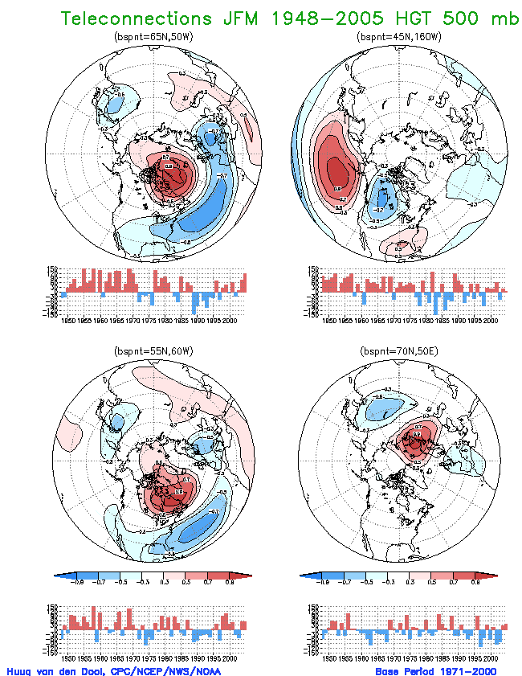
.
Fig.4.1 Display of Teleconnection for seasonal (JFM) mean 500 mb height. Shown are the correlation between the basepoint (noted above the map) and all other gridpoints (maps) and the timeseries of 500mb height anomaly (geopotential meters) at the basepoints. Contours every 0.2, starting contours +/- 0.3. Data source: NCEP Global Reanalysis. Period 1948-2005. Domain 20N-90N. On the left a pattern referred to as North Atlantic Oscillation (NAO). On the right the Pacific North American pattern (PNA).

Slide 6
The NAO pattern shows a positive correlation around its basepoint, as expected around any basepoint, but more interestingly, a very large area of negative correlation to the south stretching from North America to deep into Europe along 35-45N (sloping northward as one goes east). This means that when 500mb height is higher than usual near southern Greenland it tends to be lower than normal along 40N and vice versa. This ‘see-saw’ in 500mb height, by geostrophic approximation, modifies the strength of the westerlies (or polar jet) in between the two main centers of the NAO across the Atlantic. Further to the south, 20N-30N, heights are positively correlated with the Greenland basepoint. In the phase where the polar jet is strengthened, the subtropical jet is weakened, and vice versa. In a nutshell, this is the most famous teleconnection in the NH, discovered and named by Walker(1924), who worked with mean sea-level pressure data. The NAO is a standing oscillation - there is no implied motion of the pattern, just a change in polarity described by the sign of the time series of 500mb height anomalies at 65N,50W, which is shown directly underneath the map. There are a few scattered weaker centers of +ve and -ve correlation elsewhere over the hemisphere, but they are weak and only the one near coastal east Asia is robust. The NAO has a strong link to the alternation of westerly and blocked flow across the Atlantic and is present from the surface up into the stratosphere.
Perhaps Walker would not agree with this assessment because the alternation of strong westerlies and blocked flow at the time scales of weeks was well known in Europe in the 19th century, see Rogers and van Loon(1978).

Slide 7
The map in the right in Fig.4.1 shows positive correlations close to its chosen basepoint at 45N,160W, as expected, but now -ve correlations both ‘upstream’ near Hawaii and ‘downstream’ over west-central Canada. Furthermore, there is a positive correlation over SE North America. In contrast to the NAO, which has two (maybe three) main centers, the PNA has four main centers. The PNA centers are organized along an arching pattern, looking somewhat like EWP dispersion in 2 dimensions (see Chapter 3; Fig.3.2), and therefore is suggestive of wave energy traveling from the HI center, via the North Pacific, and from central Canada to SE North America. (We infer the direction because the group speed of Rossby waves always has an eastward component.) Extrapolating further upstream the wave energy appears to come from the deep tropics near the date line. In contrast to the Atlantic the Pacific has only a subtropical jetstream in the mean, and the PNA does modify this jet, but mainly west of 150W. As is the case with the NAO, the PNA has a clear overlap with the phenomenon of alternating periods of blocked flow, particularly in the Gulf of Alaska, and periods of stronger westerlies. The PNA was named by Wallace and Gutzler(1981), but can be found without a problem in the atlases of O’Connor(1969) and Namias(1981). Just as the NAO, the PNA is a standing oscillation which changes polarity, but does not propagate in terms of a phase speed.
This suggestion about tropical forcing explains the explosion in popularity the PNA received in the mid 1980's when a global observing capability in real time was is place for the first time during a strong El Nino event (1982/83).

Slide 8
The time series, the height anomaly at the basepoints, are often studied for long term trends. Indeed, the PNA time series suggests that the polarity opposite to what is shown in Fig. 4.1 was uncommon before 1976 (Douglas et al 1982; Trenberth 1990). The trend towards negative in the NAO time series from the 1950's to 1990's was noted also by Hurrell (1995) and linked to higher temperatures over the Eurasian continent in winter and even the global mean temperature. However, this trend has since faltered. The main variation in Fig 4.1 is inter-annual, not a long term trend.
→ It should be noted that the PNA and NAO operate in nearly distinct spatial domains. In other words, in view of Eq (2.1) these two patterns are nearly orthogonal.
This happens in a natural way, not by mathematical design, because calculating teleconnections this way has no orthogonality requirements built in. The only overlap is over eastern North America and adjacent Atlantic, where the PNA and NAO are in competition for the same variance.

Slide 9
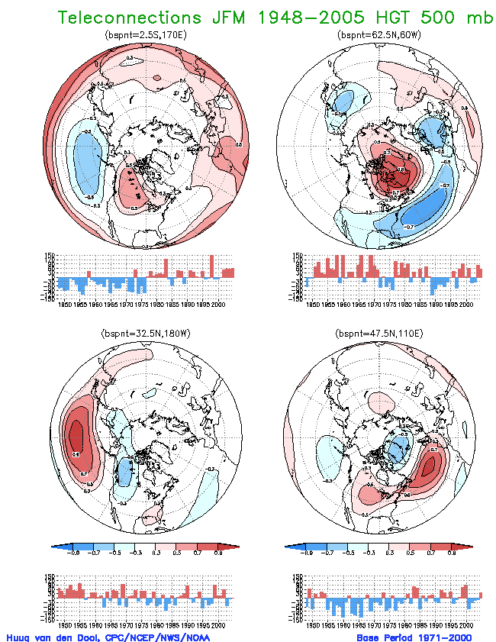
Fig.4.2. Same as Fig 4.1, but now the base point is at 2.5S and 170E, i.e. outside the display area. The values of the time series have been multiplied by 5.

Slide 10
Fig. 4.2 shows a rendition of the teleconnection that currently is most famous of all. We place the basepoint at 2.5S,170E (i.e. outside the domain displayed) and calculate the correlation of 500mb height in the deep tropics near the dateline with gridpoints over the NH (20N-pole). At this point we do not invoke SST or tropical forcing explicitly. We just note that when heights are higher than average near the dateline, heights tend to be higher than normal everywhere in the tropics (not shown), and into the subtropics and lower mid-latitudes, i.e. positive correlation over an area covering nearly half the planet. In the north of the general Pacific North American area we find negative correlation near the Aleutian Islands, and positive over NW Canada. Study of the correlation of the tropics with the extra-tropics in the PNA area was pioneered by Horel and Wallace(1981), at a time much less data was available. The positive excursions in the time series in Fig 4.2 mark the years of all the famous El Ninos (1958, 73, 83, 98). However, the time series also has a dominant upward trend, or perhaps a discontinuity near 1977, which serves as a reminder that researchers have to decide whether this is real (faithful to nature), or caused by inhomogeneities in observations used in the NCEP/NCAR Reanalysis. Another point of discussion is whether Fig.4.2 shows the PNA in mid-latitudes. After more than a decade of loosely calling the mid-latitude portion of Fig 4.2 the PNA, there is enough of a shift in space to consider the pattern associated with ENSO events in the tropics to be different from the PNA (Livezey and Mo 1986; Straus and Shukla 2002). The reader can study this by comparing Fig.4.1 and 4.2. The ENSO teleconnection modifies the subtropical jet in the Pacific, but farther east than the PNA does. Other estimates of the ENSO teleconnection will be presented in Ch 5 and 8.

Slide 11
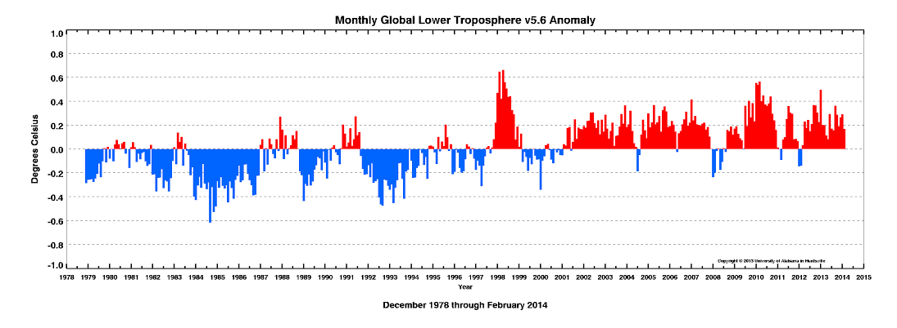
Talking about abrupt climate change…..

Slide 12
4.3 The measure of teleconnection
Table 4.1: Listing of different ways of characterizing the teleconnection between 65N,50W and 47.5N,5E (Europe).
Greenland to Europe Europe to Greenland units:
Correlation: -0.67 -0.67 non-dimensional
Regression coefficient: -0.50 -0.90 non-dimensional
Composite: > 0.5*sd -0.73 (17) -0.87 (17) standard deviation
Composite: < -0.5*sd +0.79 (20) +0.65 (22) standard deviation

Slide 13
4.4 Finding teleconnections systematically. Empirical Orthogonal Teleconnections (EOT)
Using Eq (4.1) Namias(1981) evaluated the correlation between any basepoint and all other points, i.e. for each value of i, there is a map of ρ_{ij}, 1<=j<=n_{s} .
Since i can be varied from 1 to n_{s} , one has a full Atlas of n_{s} one-point teleconnection maps. Namias(1981) provides such an Atlas for the four main seasons for 700mb height, 200 pages in all. His work was an update and extension of an Atlas by O’Connor(1969). O’Connor’s atlas in fact consisted of composites of the NH 700mb height field given that at one particular point the anomaly is in excess of some threshold - i.e. asymmetry between +ve and-ve anomalies was surveyed.
Both O’Connor and Namias had a practical application is mind. In long range forecasting one would encounter the situation of being relatively certain about the forecast at one or at most a few points in the NH, and the task was to sketch the rest of the field (by hand in those days) using the teleconnection atlas. To this day the CPC is following this process in making the 6-10 day and week2 forecasts and has an updated electronic version of O’Connor’s atlas to do this work; the most recent reference is Wagner and Maisel(1989).
The reader may wonder why 700mb was chosen originally in the 1940s. The interest in some mid-tropospheric level where the barotropic model could be applied with the most success led to a difference of opinion among Europeans (500mb) and North Americans (700mb). Once committed to the analysis at these levels the tradition continued until Reanalysis allowed researchers to chose vitually anything they want.
Actually, O’Connor (1969) had an added condition, namely that the gridpoint had to be a center of a larger scale anomaly. This reduces the amount of data one can work with, and over time this extra condition was dropped.

Slide 14
In spite of these early efforts with a practical application, there is at first sight, limited science in calculating ρ_{ij} endlessly (more output than input).
The effort to systematize these calculations with the purpose of finding just the main (very few) teleconnections started with Wallace and Gutzler(1981). They searched for those basepoints s_{i} , that have the strongest negative correlation with some remote point s_{j} (and usually with an area around s_{j} ).
They summarized their findings on a teleconnectivity map indicating areas that relate (with negative or positive correlation) to other remote areas. The two patterns in Fig. 4.1 are a summary as well in that we picked the two best situated basepoints s₁ and s₂.
Keep in mind that one also gets the PNA by taking a basepoint near HI, or Canada, but these are the redundant doubles. A third and fourth pattern can be displayed, but they explain much less variance (a topic not well developed for one point teleconnections because orthogonality is not enforced) and are far more sensitive to adding or subtracting a year in the dataset.
The PNA and NAO are robust and not too sensitive to adding or subtracting a few years, and can be found by every reasonable technique.

Slide 15
A weak point of teleconnections a la Wallace and Gutzler(1981) is that one cannot easily (by projection) represent the original data in terms of a linear combination of NAO, PNA etc. Both patterns are derived straight from the original data, and not exactly orthogonal. The latter can be done by orthogonalizing the base point teleconnection approach. Given the first point of choice (for whatever reason) s₁, one can reduce the anomaly data by:
f^{reduced} (s, t) = f (s, t) - a (s₁, s) f (s₁, t),
where a (s₁, s) is the regression coefficient between s₁ and any other point s. Then the next task is to find a 2nd point s₂ (by whatever criterion) in the reduced data. And so on for the third point, after reducing the data a 2nd time.
Gramm Schmidt procedure.

Slide 16
The temporal correlation between f (s₁, t) and f ^{reduced} (s_{j}, t) is zero for all j. Because of this orthogonality (in time) this procedure allows functional representation as per Eq (2.7a) as follows:
M
f (s, t) = < f (s , t) > + ∑ a(s_{m}, s) f( s_{m}, t) 1 <= s <= n_{s} 1 <= t <= n_{t} (4.2)
m=1
where a (s_{m}, s) and f (s_{m}, t) are derived from m-1 times reduced data.
In addition to functional representation one now can also define the notion explained variance by each teleconnection pattern. In fact explained variance gives the most rational basis for choosing s₁, s₂ etc in a certain order. One wants to maximize EV(i), i.e. find that s_{i} (by brute force) for which
n_{s}
EV(i) = ∑ ρ²_{ij} * q_{jj} (4.3)
j=1
is the highest.
Fig 4.3 shows a map of EV(i), i=1, n_{s}, for the JFM 500mb data.

Slide 17
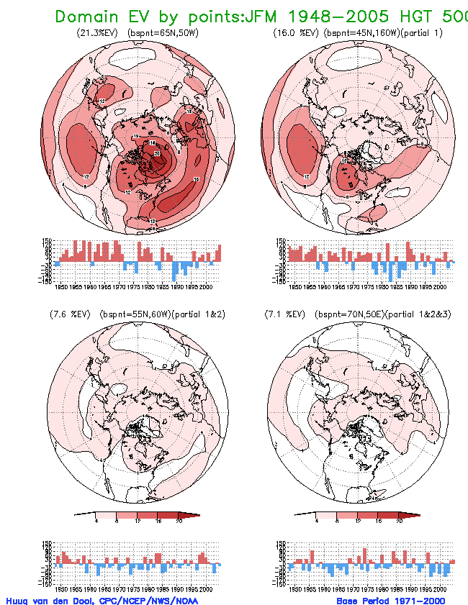
Fig. 4.3 EV(i),the variance explained by single gridpoints in % of the total variance, using equation 4.3. In the upper left for raw data, in the upper right after removal of the first EOT mode, lower left after removal of the first two modes. Contours every 4%. The timeseries shown are the residual height anomaly at the gridpoint that explains the most of the remaining domain integrated variance.

Slide 18
If one follows the procedure described above to pick s₁, s₂ etc, one obtains functions named Empirical Orthogonal Teleconnections, see Van den Dool et al(2000), or at least one version of them.
Fig. 4.4 is like Fig. 4.1 but presented as EOTs. The two first basepoints in both Figs.4.1 and 4.4 were chosen by maximizing explained variance as per Eq (4.3).
While the two patterns in Figs 4.1 and 4.4 look very similar there are these differences in methodology and display:
Fig. 4.1 has correlation, Fig. 4.4 has regression a (s_{m} ,s).
Fig. 4.1 is derived from full original anomaly data, while in Fig.4.4 the m’th pattern is derived from m-1 times reduced data.
Teleconnections are chosen for the existence of remote -ve correlation, while EOTs include a premium for explaining variance nearby, i.e nearby positive correlation adds to EV(i).
Fig.4.4 is consistent with Eq 4.3 and the notion ‘explained variance’ now has a meaning.
In spite of these differences, EOT still resembles the well known one-point teleconnection patterns, at least for the first few modes, but has the advantages of functional representation and explained variance. EOT are much like EOFs (next chapter), and are almost indistinguishable from the most common type of rotated EOF (Smith et al 2003; Rennert and Wallace 2004/5).

Slide 19
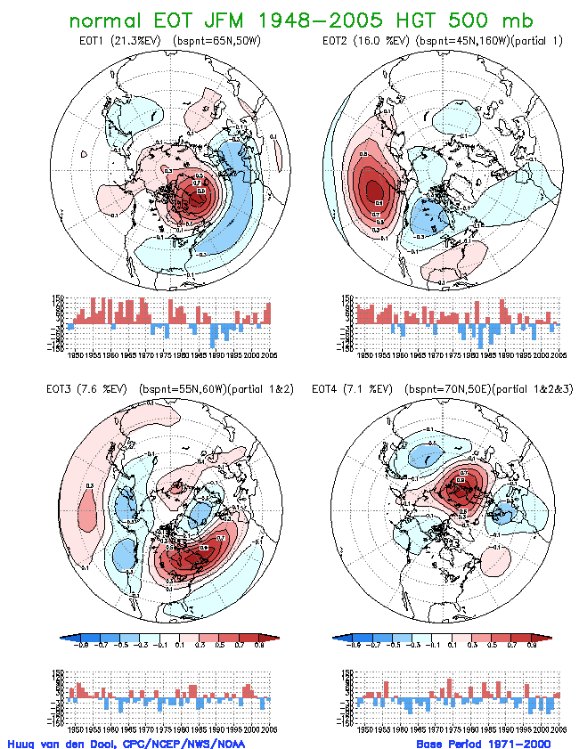
Fig.4.4 Display of four leading EOT for seasonal (JFM) mean 500 mb height. Shown are the regression coefficient between the height at the basepoint and the height at all other gridpoints (maps) and the timeseries of residual 500mb height anomaly (geopotential meters) at the basepoints. In the upper left for raw data, in the upper right after removal of the first EOT mode, lower left after removal of the first two modes. Contours every 0.2, starting contours +/- 0.1. Data source: NCEP Global Reanalysis. Period 1948-2005. Domain 20N-90N

Slide 20
4.5 Discussion
There is a large body of literature since the early 1980's that attempted to study teleconnections via EOFs, but EOFs nearly always had to be rotated (Horel 1981; Barnston and Livezey 1987) so they would better resemble the Wallace and Gutzler one point correlations. Barnston and Livezey (1987) gave an exhaustive classification of teleconnections, using rotated EOF, well beyond just NAO and PNA, for all 12 months of year. EOTs are much simpler to calculate than rotated EOF, with no truncation and rotation recipe required.
Much has been made in the literature over the past twenty five years about the shape and orientation of ‘eddies’. The summary is that low frequency eddies are more often identified as zonally elongated, while the high frequency eddies are more often meridionally elongated. Eddies in different frequency bands are typically obtained by applying a digital filter to the observations. In this chapter the examples always used seasonal mean data, thus emphasizing zonally elongated eddies suggestive of meridional energy transport. At the very least the PNA looks like very much that. The NAO is also zonally elongated, but the suggestion of wave energy passing through is weak. If one studies high frequency filtered data, one is more likely to find transient teleconnections of the meridionally elongated variety, somewhat like the EWP1 dispersion of a source in mid-latitude. In reality, in unfiltered data, both types are present as can be seen from the EWP2 dispersion in Chapter 3. The reason EWP1 looks more like high frequency may be that the group speed is enhanced in the zonal direction by the background wind, see Appendix Chapter 3, so zonal dispersion is inherently on a faster time scale than meridional dispersion.

Slide 21
While the PNA is likely explained in part by wave propagation, the NAO is. The NAO remains somewhat of a mystery being highly weather related on the one hand (Franske et al 2004 ) but often invoked to explain interdecadal climate variability on the other (Hurrell 1995). Wallace and Thompson(1998) have speculated that the NAO is a manifestation of something more fundamental, namely variation in the zonal mean zonal wind, something relevant to all longitudes, not just the Atlantic basin. Indeed, in the stratosphere and the Southern Hemisphere such zonally invariant variations appear very important. In this context they introduced the ‘annular mode’ (initially called Arctic Oscillation (AO)), but the AO cannot be found in the Northern Hemisphere troposphere by traditional teleconnection methods (Ambaum et al 2002; this chapter).
There is no counterpart to the NAO in the Pacific basin, at least nothing of that importance in terms of EV. Some studies have reported independent east and west Pacific Oscillations, but they are weak in EV. A fruitful approach is to study how NAO and PNA in their respective polarities change latitude and/or strength of the climatological jet streams in the Pacific and Atlantic basin (Ambaum et al 2002).

Slide 22
It would be an overstatement to say we understand teleconnections. Even if the PNA is explained by wave energy propagation, we have not explained why it is where it is, or why there are no PNA look alikes at other longitudes. Moreover, no-one has ever seen the PNA or NAO - even at record breaking projections the flow across the Atlantic does not look all that much like the canonical NAO. Another research issue: What is the relationship of the Icelandic Low and the Azores High (two climatological fixtures) to the two main poles (anomalies) of the NAO??
The reader should note that a systematic search for teleconnections on seasonal mean Z500 from 20N to the pole in JFM yielded the NAO and PNA, so where exactly is the ENSO teleconnection?
Originally it was thought that the PNA is the vehicle that brings the tropical ENSO into the mid-latitudes, but this view is no longer universally held. The EOT approach allows one to chose a time series from outside the domain of analysis, here 20N-pole, for instance a time series that represents ENSO. Fig. 4.2 may be seen in this light. Forcing an ENSO pattern as the first mode explains only 8% of the Z500 variance. The next EOT modes after the first forced mode is removed are the PNA and NAO with 3 and 1% EV less than before. This suggests that NAO and PNA in Z500 are modes primarily internal to mid-latitudes. Does this mean ENSO is unimportant?
ENSO becomes a more important component of the NH by any of the following steps: 1) extend the domain slightly southward to 10N or the equator, 2) standardize the Z500 variable, i.e. de-emphasize the high variance Z500 areas in high latitudes, 3) use streamfunction instead of height. Some of the calculations in Chapter 5 will bring out this point.

Slide 23
4.5. Monitoring, indices and station data
Because of their importance, several institutions keep track of NAO, PNA etc in real time. The favored method is to express the state of these modes by an ‘index’.
The index could, in principle, be something mildly complicated (projection coefficients of an EOF), but is usually more simple. In view of Fig.4.1 and in the spirit of Wallace and Gutzler(1981) an NAO index could be defined as
the height anomaly at a single point 50W, 65N (Z’(50,65)), or
(Z’(50,65)-Z’(50,30))/2.
Because these two locations are supposedly in a high -ve correlation the average in option b) is a less noisy estimate of the state of the NAO. (Because tradition says that high index corresponds to strong westerlies the NAO-index is actually the negative of a) and b)). Some have taken areal averages around such points in order to further suppress noise. The PNA would be an average of four locations with the sign reversed between the even and odd entries. Standardization can be applied to force the index to have unit standard deviation. There are no official indices, accepted by a majority of researchers or institutions.

Slide 24
As long as we deal with gridded data one can chose the appropriate optimal gridpoints. But this is possible only in the post 1948 era (Reanalysis!).
Extending the indices back to the early 20th and 19th century is possible only by making a few compromises. The gist of the main compromise is to adjust the index to where we happen to have station data. Another is to use surface data only.
For the NAO one still gets a good index, check Fig.4.1, by using a single sea-level pressure station in say Iceland, and the other in Portugal. (This statement is mildly incorrect if the spatial pattern itself has secular changes or varies too much with season. This explains the sudden fame of humble places like Stykkishólmur in Iceland and Ponta Delgada on the Azores. Both of these stations have data back to the mid-19th century.

Slide 25
Much the same can be said about the ENSO index. Gridded tropical analyses have not been available for more than 25 years, so station data had been used widely prior to 1980 to measure the so-called Southern Oscillation Index (SOI) as sea-level pressure at Tahiti minus Darwin in Australia (Chen 1982). Subsequent global Reanalyses have indicated somewhat better situated gridpoints but the ‘equatorial SOI’ (Kousky 1999) has not caught on. Moreover for extension back into the 19th century one must use Tahiti, Darwin (or Batavia/Djakarta). Meanwhile the atmospheric SOI is losing in popularity against an oceanic definition (called mysteriously ‘Nino3.4', see Barnston et al(1997)), which is the SST averaged over 5S-5N and 170W-120W. For the PNA we have less luck in building longer data sets because there is a lack of surface station data in the Pacific, even today.
There is an apparent contradiction in using a single (or a few) points and measuring the state of a large-scale pattern spanning the earth. This is the mystery of teleconnections. One can project data onto a large scale pattern, but the time series of the projection coefficients is very highly correlated to the data at a single point (which was selected for having that property). It is truly remarkable that pressure at a single location like Darwin in the fall has useful predictive information for winter in some far away mid-latitude areas. All observations are irreplaceable, but some observations are even more valuable than others.

Slide 26
Closing comment
In this chapter we discussed simultaneous teleconnections, as is done in most teleconnection studies. In truth teleconnections are not simultaneous. If there is a perturbation somewhere in the system, it takes days or weeks or months for the effect to be felt far away. Moreover, the restriction of simultaneity would appear to reduce application to prediction.
So why are (simultaneous) teleconnections so often mentioned in connection with seasonal prediction? The best illustration is ENSO. If we forecast a large positive or negative ENSO index (such as the Nino3.4 anomaly) for next winter we assume that the simultaneous teleconnection into the (lower) mid-latitudes will be automatically there. The interpretation of the simultaneous teleconnection is enriched by the interpretation of cause and effect, and how energy flows. The application of the teleconnection towards prediction is possible when the upstream cause is predictable to a certain degree.
Application of diagnostic knowledge about the NAO and PNA towards prediction is much harder.

Slide 27
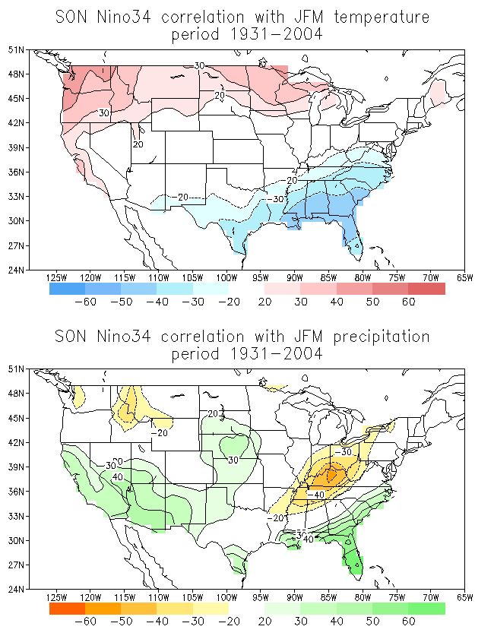
Fig. 8.6: The correlation (*100.) between the Nino34 SST index in fall (SON) and the temperature (top) and precipitation (bottom) in the following JFM in the United States. Correlations in excess of 0.2 are shaded. Contours every 0.1 – no contours for -.1, 0 and +0.1 shown.

