Slide 1
Chapter 2. Background on Orthogonal Functions and Covariance
The purpose is to present some basic mathematics and statistics that will be used heavily in subsequent chapters. The organization of the material and the emphasis on some important details peculiar to the geophysical discipline should help the reader.
2.1 Orthogonal Functions
Two functions f and g are defined to be orthogonal on a domain S if
∫ f(s) g(s) ds = 0 (2.1)
S
where s is space, 1, 2 or more dimensions, and the integral is taken over S.
Since we will work with data observed at discrete points and with large sets of orthogonal functions we redefine and extend a discrete version of (2.1) as
n_{s}
∑ e_{k}(s) e_{m}(s) = 0 for k ≠ m
s=1
= positive for k = m (2.2)
= 1 for k = m; orthonormal
The summation is over s = 1 to n_{s} , the number of (observed) points in space. The e_{k}(s) are basis functions, orthogonal to all e_{m}(s), k ≠ m. The functions e_{k}(s) are said to be orthonormal when the rhs in (2.2) is either zero or unity.

Slide 2
a ‘detail’:
For non-equal area data, such as on a latitude/longitude grid, or for irregular station data, the summation involves a weighting factor w(s), i.e.
∑ w(s) e_{k}(s) e_{m}(s), 1 <= s <= n_{s}
s
where w(s) is related to the size of the area each data point represents. Except when noted otherwise, w(s) will be left off for simplicity. However this detail is not always trivial.
The e_{m}(s) can be thought of as vectors consisting of n_{s} components.
In that context the type of product in (2.2) is often referred to as inner or dot product e_{k} . e_{m} .

Slide 3
A major convenience of a set of orthogonal functions e_{m}(s) is functional representation of data, that is to say, for any discrete f (s), say a map of Mean Sea Level Pressure on a grid, we can write:
M
f (s) = [ f ] + ∑ α_{m} e_{m}(s) 1 <= s <= n_{s} (2.3)
m=1
where [ f ] is the spatial mean, α_{m} is the expansion coefficient, and M is at most n_{s}-1. In the context of (2.3) it is clear why the e_{m}(s) are called a basis. The equal sign in (2.3) only applies when the basis is complete.
For now, let’s consider [ f ] to be zero. We now define the spatial variance (SV) as:
SV = ∑ f ²(s) / n_{s} (2.4)
s
and note that SV, for orthonormal e_{m}(s), can also be written as
M
SV = ∑ α_{m} ² (2.5)
m=1
which establishes the link between variance in physical (2.4) and spectral space (2.5). The equal sign in (2.5) only applies when M is the required minimum value, which could be as high as n_{s}-1.

Slide 4
As per (2.5) each basis function ‘explains’ a non-overlapping part of the variance, or (put another way) contributes an independent piece of information contained in f (s). α²_{m} is the classical Fourier power spectrum if the e’s are sin/cos on the domain. In that context (2.5) is known as Parceval’s theorem, and counting the sin/cos pair as one mode, M is at most n_{s}/2.
When e is known, then α_{m} can be easily calculated as:
α_{m} = ∑ f (s) e_{m}(s) 1 <= m <= M (2.6)
s
i.e one finds the projection coefficients α_{m} by simply projecting the data f (s) onto the e’s. (2.6) is only valid when the e’s have unit length (orthonormal). If not divide rhs of (2.6) by ∑ e²_{m}(s).
Since orthogonal functions do not compete for the same variance, (2.6) can be evaluated for each m separately, and in any order. The ordering m = 1 to M is quite arbitrary. When sin/cos is used the low m values correspond to the largest spatial scales. But ordering by amplitude (or equivalently: explained variance) makes a lot of sense too.

Slide 5
If one were to truncate to N functions (N<M) the explained variance (EV) is given by (2.5), but summed only over m = 1 to N, so ordering orthogonal functions by EV is natural and advantageous for many purposes.
When the α_{m} and e_{m}(s) are both known, the data in physical space can be retrieved via (2.3). When the α_{m} and f(s) are known, a hypothetical situation, e_{m}(s) cannot be retrieved in general.
It is necessary to reflect where the physical units reside in (2.3)-(2.6).
If f(s) is say pressure, the α_{m} assume the unit hPa, and the SV has the unit hPa². The e_{m}(s) are dimensionless, and it is convenient for e_{m}(s) to have unit length, such that the numerical values of α_{m} and SV make sense in physical units hPa and hPa² respectively.

Slide 6
The above was written for unspecified orthogonal functions. There are many orthogonal functions. Analytical orthogonal functions include the sin ms, cos ms pair (or cos m(s- phase angle )) as the most famous of all - in this case (2.6) is known as the Fourier transform. Legendre polynomials, and spherical harmonics (a combination of sin/cos in the east west direction and Legendre in the north south direction) are also widely used in meteorology, starting with Baer and Platzman(1961).
But the list includes Bessel, Hermite, Chebyshev, Laguerre functions etc etc. Why prefer one function over the other? There are issues of taste, preference, accuracy, theory, scaling, tradition, ...convenience. We mention here specifically the issue of ‘efficiency’. For practical reasons one may have to truncate, in (2.3), to much less than M.
If only N orthogonal functions are allowed (N<M) it matters which orthogonal functions will explain the most variance. The remainder is relegated to unresolved scales, unexplained variance and truncation error.
{A different type of efficiency has to do with the speed by which transforms like (2.3) and (2.6), can be executed on a computer.}

Slide 7
One can easily imagine non-analytical orthogonal functions. Examples include zeros at all points in space except one - this makes for a set of orthogonal functions equal to n_{s} . An advantage of classical analytical functions is that there is theory and a wealth of information. Moreover, analytical functions suggest values and meaning in between the data points. This makes differentiation and interpolation easy. Nevertheless, ever since Lorenz(1956) non-analytical empirical orthogonal functions (no more than a set of numbers on a grid or a set of stations) are highly popular in Meteorology as a device to “let the data speak”. Moreover, these empirical orthogonal functions (EOF) are the most efficient in explaining variance for a given data set.
We have written the above, (2.1) thru (2.6), for space s. One can trivially replace space s by time t (1 <= t <= n_{t}) and keep the exact same equations showing t instead of s. However,

Slide 8
However, if one has a space-time data set, f (s, t), the situation becomes quickly more involved. For instance, choosing orthogonal functions, as before, in space, (2.3) can be written as:
M
f (s, t) = [ f (s, t) ] + ∑ α_{m}(t) e_{m}(s) 1 <= s <= n_{s} 1 <= t <= n_{t} (2.7)
m=1
where the projection coefficients and the space mean are a function of time.
While choosing orthogonal functions in time would lead to:
M
f (s, t) = < f (s , t) > + ∑ α_{m}(s) e_{m}(t) 1 <= s <= n_{s} 1 <= t <= n_{t} (2.7a)
m=1
where the time mean, and the projection coefficients are a function of space. Time mean is denoted by < > .
Eq (2.7) and (2.7a) lead, in general, to drastically different looks of the same data set, sometimes referred to as T-mode and S-mode analysis. There is, however, one unique set of functions for which this space-time ambiguity can be removed: EOFs, i.e α_{m}(t) in (2.7) is the same as e_{m}(t) in (2.7a), and α_{m}(s) in (2.7a) is the same as e_{m}(s) in (2.7). We phrase this as follows: For EOFs one can reverse (interchange) the roles of time and space. This does, however, require a careful treatment of the space-time mean, see section 2.3.

Slide 9
2.2 Correlation and Covariance
Here we discuss elementary statistics in one dimension first (time) and use as a not-so-arbitrary example of two times series, D(t) the seasonal mean pressure at Darwin in Australia near a center of action of a phenomenon called ENSO, and seasonal mean temperature T(t) at some far away location in mid-latitude: T(t), 1<=t<= n_{t} , where t is a year index, 1948..2005 say; n_{t}=58). One can define the time mean of D as
n_{t}
<D> = ∑ D(t) / n_{t}, (2.8)
t=1
and T similarly has a time average <T>.
We now formulate departures from the mean, often called anomalies:
D’(t) = D(t) - <D>
for all t (2.9)
T’(t) = T(t) - <T>

Slide 10
The covariance between D and T is given by
cov_{DT} = ∑ D’(t) T’(t) / n_{t} (2.10)
The physical units of covariance in this example are (hPa ºC ).
The variance is given by
var_{D} = ∑ D’(t)D’(t) / n_{t}, (2.11)
and similarly for var_{T} . The standard deviation is sd_{D} = ( var_{D} )^{1/2} ,
and the correlation between D and T is:
ρ = cov_{DT} / ( sd_{D} . sd_{T} ) (2.12)
The correlation is a non-dimensional quantity, -1 <= ρ <= 1.
Calling D the predictor, and T the predictand, there is a regression line T’_{fcst} = b D’ which, over t = 1, n_{t} , explains ρ ² % of the variance in T. The subscript ‘fcst’ designates a forecast for T given D. The regression coefficient b is given by
b = ρ sd_{T} / sd_{D} (2.13)
The correlation has been used widely in tele-connection studies to gauge relationships or ‘connection’ between far away points.

Slide 11
The suggestion of a predictive capability is more explicit when D(t) and T(t), while both time series of length n_{t}, are offset in time, D leading T. Example.
If D and T are the same variable at the same location, but offset in time, the above describes the first steps of an auto-regressive forecast system. Note also that the correlation is used frequently for verification of forecasts against observations.
In many texts the route to (2.12) is taken via ‘standardized’ variables, i.e. using (2.8), (2.9) and (2.11) we define:
D”(t) = ( D(t) - <D> ) / sd_{D} (2.9a)
which have no physical units. Given these standardized anomalies, correlation and covariance become the same and are given by
ρ = cov_{D’’T’’} = ∑ D “(t) T ”(t) / n_{t} (2.12a)
t
So, the correlation does not change wrt (2.12), but the covariance does change relative to (2.10) and loses its physical units.

Slide 12
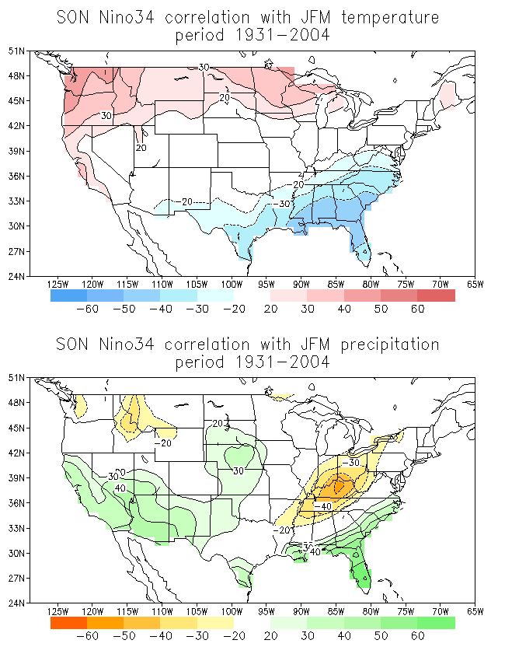
Fig. 8.6: The correlation (*100.) between the Nino34 SST index in fall (SON) and the temperature (top) and precipitation (bottom) in the following JFM in the United States. Correlations in excess of 0.2 are shaded. Contours every 0.1 – no contours for -.1, 0 and +0.1 shown.

Slide 13
It should be trivial to replace time t by space s in (2.8) - (2.12) and define covariance or correlation in space in analogous fashion. Extending to both space and time, and using general notation, we have a data set f (s , t) with a mean removed. The covariance in time between two points s_{i} and s_{j} is given by
q_{ij} = ∑ f (s_{i}, t) f (s_{j} , t) / n_{t} (2.14)
t
while the covariance in space between two times t_{i} and t_{j} is given by:
qª_{ij} = ∑ f (s, t_{i} ) f (s, t_{j} ) / n_{s} (2.14a)
s
q_{ij} and qª_{ij} are the elements of the two renditions of the all-important covariance matrices Q and Qª - the superscript a stands for alternative. The n_{s} by n_{s} matrix Q measures ‘teleconnection’ between any two points s_{i} and s_{j} while the n_{t} by n_{t} matrix Qª measures the similarity of two maps at any two times t_{i} and t_{j} , a measure of analogy. These two features (teleconnection and analogy) are totally unrelated at first thought, but under the right definitions the eigenvalues of Q and Qª are actually the same, such that the role of space and time can be thought of as interchangeable. One issue to be particularly careful about is the mean value that is removed from f(s,t). This has strong repercussions in both sections 2.1 and 2.2.
When a non-equal area grid is used the expression has to be adjusted in a calculation as follows:
qª_{ij} = ∑ w(s) f (s, t_{i} ) f (s, t_{j} ) / W (2.14a)
where w(s) represents the size of the area for each data point in space, and W is the sum (in space) of all w(s). On the common lat-lon grid the weight is cos(latitude).

Slide 14
2.3 Issues about removal of “the mean”.
An important but murky issue is that of forming anomalies. The general idea is one of splitting a datum into a part that is easy to know (some mean value we are supposed to know), and the remainder, or anomaly, which deals with variability around that mean and is a worthy target for prediction efforts. All attention is subsequently given to the anomaly. Should it be f’(t) = f (t) - <f> as in Eq (2.9) or f ‘(t) = f(t) - {f}, where {f} is a reference value, not necessarily the sample time mean. This is a matter of judgment. Examples where this question arises:
a) When the mean is known theoretically. (There may be no need to calculate a flawed mean from a limited sample)
b) When forecasts are made of the type: “warmer than normal”, w.r.t. a normal which is based on past data by necessity at the time of issuance of the forecast.
c) The widely used anomaly correlation in verification, see inset/appendix.
d) In EOF calculations (a somewhat hidden problem)
e) When the climatology is smoothed across calendar months, resulting in non-zero time mean anomalies at certain times of the year.
While no absolute truth and guidelines exist we here take the point of view that removal of a reference value, acting as an approximate time mean, is often the right course of action. The removal of a space mean is not recommended. And ∑ f’(s)≠ 0 and ∑ f’(t)≠ 0 are s t
acceptable. Removal of a calculated space mean is problematic. On planet earth, with its widely varying climate removing a space mean first makes little sense as it creates, for example, “anomalies” warmer(colder) than average in equatorial(polar) areas.

Slide 15
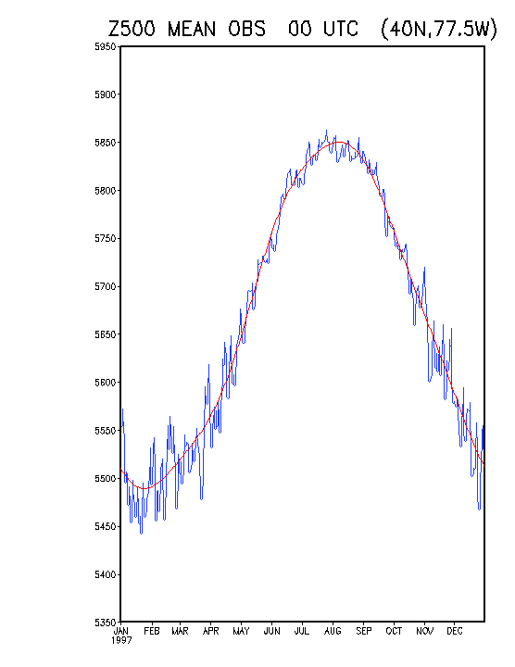
The observed climatological annual cycle of the 500mb geopotential height at a grid point close to Washington, DC, is shown as a smooth red curve based on four harmonics. The 24-yr mean values as calculated directly from the data are shown by the blue curves. Unit is m.
(Johansson, Thiaw and Saha 2007)

Slide 16
Given a space-time data set f (s, t) we will thus follow this practice.
1) Remove at each point in space a reference value { f (s) }, i.e form anomalies as follows:
f ’ (s , t) = f (s, t) - { f (s) } (2.15)
In some cases and examples the { } reference will be the sample time mean, such that anomalies do sum up to zero over time and f’ is strictly centered. But we do not impose such a requirement.
2) We do NOT remove the spatial mean of f ’.
Under this practice we evaluate (2.14) and (2.14a). We furthermore note that under the above working definition the space-time variance is given by
STV = ∑ f ‘²(s,t) /( n_{s} n_{t} ) (2.16)
s,t
Exactly the same total variance to be divided among orthogonal functions (EOF or otherwise) calculated from either Q or Qª. We acknowledge that some authors would take an additional space mean out when working with Qª . This, however, modifies the STV, and all information derived from Qª would change. Especially on small domains, taking out the space mean of f ‘ takes away much of the signal of interest. We thus work with anomalies that do not necessarily sum up to exactly zero in either time or space domain. This also means that variance and standard deviation, as defined in (2.11), (2.12) and (2.16) are augmented by the (usually small) offset from zero mean. When calculating EOFs the domain means get absorbed into one or more modes.

Slide 17
2.4 Concluding remarks
We approach the representation of a data set f (s, t) = [ f (s, t) ] + ∑ α_{m}(t) e_{m}(s) both by classical mathematical analysis theory and by basic statistical concepts that will allow calculation of orthogonal functions from a data set (mainly in Chapter 5). It may be a good idea to reflect on the commonality of section 2.1 and 2.2 and the juxtaposition of terminology. For example, the inner product used to determine orthogonality (2.1) is the same as the measure for covariance (or correlation) in (2.10). Indeed a zero correlation is a sure sign of two orthogonal time series or two orthogonal maps. In both sections 2.1 and 2.2 we mentioned the notion of explained variance (EV), once for orthogonal functions, once for regression. We invited the reader to follow the physical units, and numerically the numbers should make sense when the basis is orthonormal. This task becomes difficult because the use of EOFs allows basis functions to be orthogonal in time and space simultaneously - both are basis function and projection coefficients all at the same time. We emphasized the ‘interchangeability’ of time and space in some of the calculations. We finally spent some paragraphs on removing a mean, which, while seemingly a detail, can cause confusion and surprisingly large differences in interpretation.

Slide 18
Appendix The anomaly correlation.
One of the most famous and infamous correlations in meteorology is the anomaly correlation used for verification. It has been in use at least since Miyakoda(1972). The procedure came from NWS-NWP efforts after years of floundering.
Imagine we have, as a function of latitude and longitude, a 500 mb height field Z (s). The field is given on a grid. How to correlate two 500 mb height maps?, like for instance Z_{fcst} and Z_{o} , a set of paired forecast/observed maps, a challenge faced each day by operational weather forecast centers. The core issue is forming anomalies or splitting Z into a component we are supposed to know (no reward for forecasting it right) and the much tougher remainder. A definitely ‘wrong way’ would be to form anomalies by Z*(s) = Z (s) - [Z] where [Z]= ∑ Z(s) /n_{s}, a space mean. Removal of a calculated space mean is problematic. R
Removing a space mean makes little sense as it creates, for example, anomalies warmer/colder than average in equatorial/polar areas. Even a terrible forecast would have a high correlation.
There is no absolutely right or wrong in these issues. In a 2D homogeneous turbulence experiment time and space means would be expected to be the same, so taking out the space mean may be quite acceptable.

Slide 19
A ‘better way’ is to form anomalies is via Z’(s) = Z(s) - Z_{climo} (s) and likewise Z’_{fcst}(s) = Z_{fcst}(s) - Z_{climo} (s) where Z_{climo} (s) is based on a long multi-year observed data set Z ( λ , φ , pressure level, day of the year, hour of the day .......). The anomaly correlation is then given by
∑ Z’_{fcst} (s) Z’_{o} (s) / n_{s}
AC = -------------------------------------------------------- (2.17)
[ ∑ Z’_{fcst} (s) Z’_{fcst} (s) / n_{s} . ∑ Z’_{o} (s) Z’_{o} (s) / n_{s} ] ^{½}
where summation is over space. -1 <= AC <= 1.
Among the debatable issues: should ∑ Z’(s) be (made) zero?? There is no reason to do that, especially in verification, but some people feel that way. The removal of the space mean removes a potentially important component of the forecast from the verification process. This is especially true on small domains that may be dominated by anomalies of one sign.
Note that -1 <= AC <= 1, like a regular correlation, even though the spatial means are not exactly zero and the two terms in the denominator are augmented versions of the classical notion variance.
Eq(2.17) is for a single pair of maps. When we have a large set of paired maps we sum the three terms in (2.17) over the whole set, then execute the multiplication and division.

Slide 20
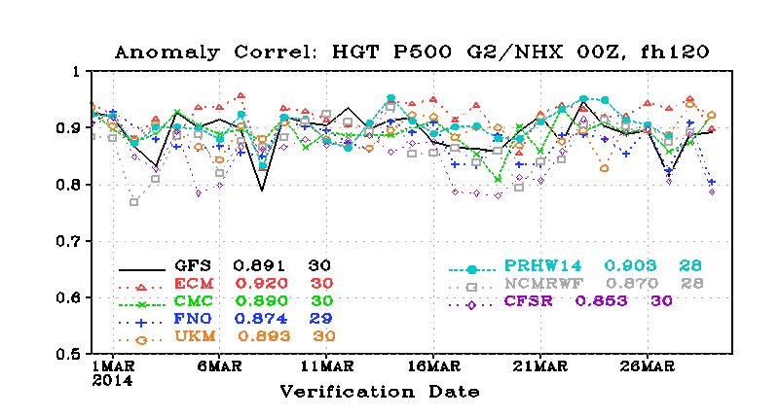

Slide 21
Source of knowledge I :
1st Principles of Physics
Source of knowledge II :
Observations f ( s , t )
Data processing
Stats package
Aspects of Atmospheric/Oceanic Behavior
Questions that arise:
Are 1st principles correct and complete?
Can we make a forecast with “skill”
!! Statistics is not just regression and MSE minimization!

